Slide 1
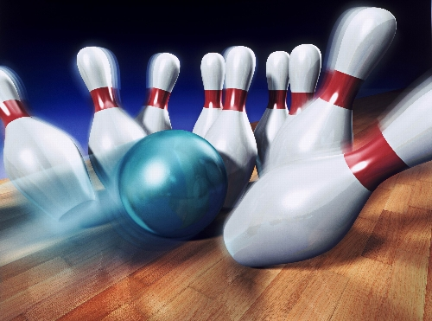
BOWLING
Individual Sports

Slide 2
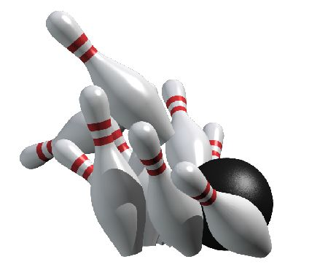
HISTORY
There are many forms of bowling, with one of the most recent being ten-pin bowling, also known as the norm.
The earliest most primitive forms of bowling can be dated back to Ancient Egypt and the Roman Empire.
An outdoor game for most of its history, bowling became popular in the mid-nineteenth century after the introduction of indoor lanes in New York in 1840 using only 9 pins.

Slide 3
HISTORY
In 1841, most states, including New York, banned "bowling at the game of ninepins" because of widespread gambling. It is popularly believed that today's game of tenpins was devised to circumvent the laws against the game of ninepins.
The first standardized rules were established in New York City, on September 9, 1895.
Today, bowling is enjoyed by 95 million people in more than ninety countries worldwide and continues to grow through entertainment media such as video games for home consoles and handheld devices.

Slide 4
HOW TO PLAY
Bowling is an individual sport, one can play on their own or against other competitors.
Play begins with a person throwing (“bowling”) the ball down a lane.
One bowling game consists of 10 frames. Each frame is equal to one turn for the bowler.
The bowler's objective is to knock down as many pins as possible in a frame, ideally all of them.
A bowler can roll the ball twice in each frame, provided that he does not hit a strike.

Slide 5
BOWLING SAFETY
In a regulation game of bowling, one must wear proper bowling shoes.
Make sure you choose a proper weight when it comes to the ball; it should be something you can control when throwing and that your fingers fit comfortably into.
Stay behind the foul line when rolling your ball
Make sure your hands are completely dry before you pick up the ball to start bowl each time. If your hands are still sweaty, the ball can slip out of your hands.
Bowlers should keep hands clear of return ball mechanism until all balls have come to a complete stop

Slide 6
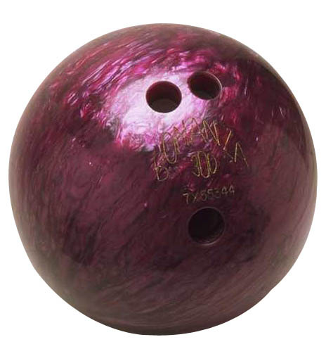
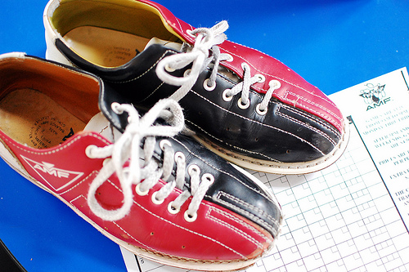
BOWLING EQUIPMENT
Ball
Shoes
Bags

Slide 7
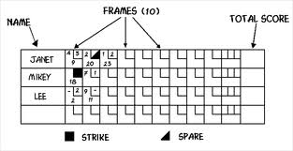
FRAME
Each bowler’s individual turn, consisting of 2 balls or 1 ball in a case of a strike; 10 frames constitute a game. If any pins remain after the bowler's turn, it's called an "open frame."

Slide 8
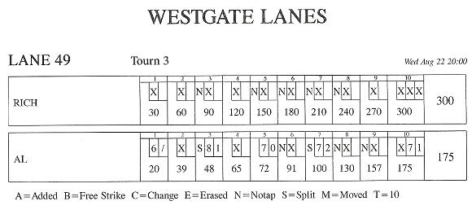
Scoring
If a bowler has an open frame, then he simply gets credit for the number of pins he knocked down.
However, if a bowler hits a spare, then he should place a slash mark on his score sheet. After his next turn, he will receive 10 points plus the number of pins he knocks down with that turn.
So if he knocks down 3 pins after his first turn, then he will get 13 points before his second turn. If he then knocks down 2 pins in his second turn, he gets a total of 15 points for that round.
If a bowler hits a strike, he should record an X on his scoresheet. The strike will earn the bowler ten points plus the number of pins knocked down on the player's next two turns in the following round.
A perfect game has 12 strikes and not ten, because if the bowler gets a strike on the last frame, then he can take two more turns.
The most a bowler can score in one game is 300 points.

Slide 9
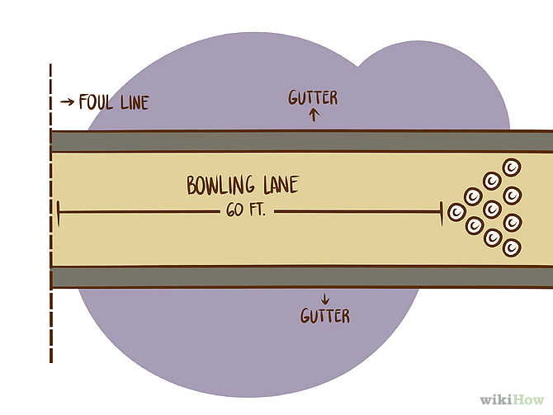
Bowling Lane
A bowling lane is 60 feet long from the foul line to the head pin.
There are gutters on either side of the bowling lane. If a ball veers off the lane, it goes into the gutters and is out of play.
The approach area is 15 feet long and ends at the foul line. The bowler cannot overstep the foul line during his approach or his shot won't count.

Slide 10
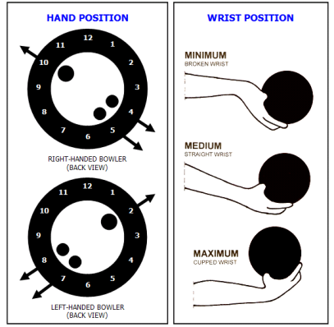
TWO TO EIGHT O’CLOCK HAND POSITION
A hand position for left-handed bowlers, the thumb points at two o’clock, the pointer finger at nine o’clock, and the pinky between six and seven o’clock

Slide 11
TEN TO FOUR O’CLOCK HAND POSITION
A hand position for right-handed bowlers, the thumb points at ten o’clock, the pointer finger at three o’clock, and the pinky finger points between five and six o’clock

Slide 12
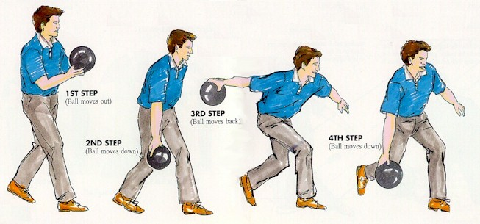
APPROACH
The area where bowlers start the bowling action

Slide 13
FOUR STEP DELIVERY APPROACH
The basic beginning approach to bowling consisting of the stance, push-away, approach, swing, and follow through
FOUR STEP APPROACH VIDEO

Slide 14
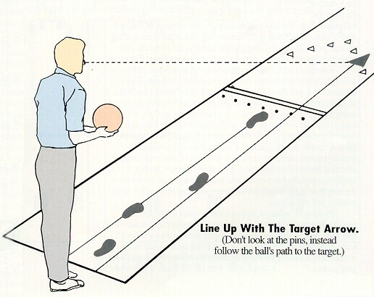
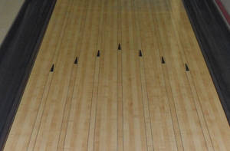
TARGET ARROWS
A visual ball alignment target for bowlers that is displayed on the lane

Slide 15
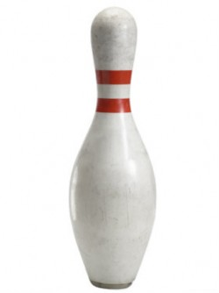
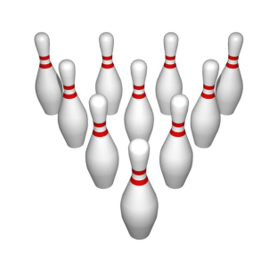
Bowling Pins
Ten pins are arranged at the end of the bowling lane at the beginning of every frame.
They are arranged in a triangle formation, with the point of the triangle facing the bowler.
The locations of the pins are assigned numbers 1-10, the head pin is pin 1.
All pins will earn the bowler one point if they are hit.

Slide 16
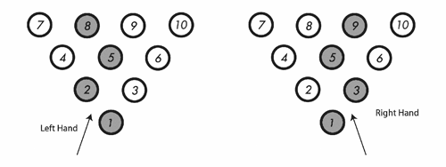
1-3 POCKET
Refers to a location on the set of pins; It is the strike pocket for right-handed people; left-handed people use the 1-2 pocket.

Slide 17
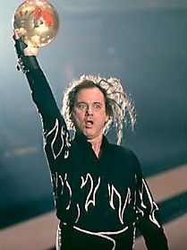
Some Bowling Lingo
Strike
Spare
Split
Gutter Ball
Turkey
Approach
Foul
Hook
Frame
Open Frame

Slide 18
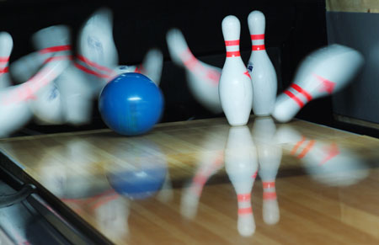
SPARE
STRIKE
Term used for knocking down all 10 pins using 2 balls in a frame.
Term used for knocking over all of the pins using 1 ball in a frame.

Slide 19
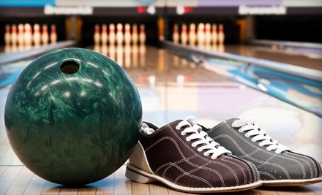
BOWLING FOR STRIKES

Slide 20
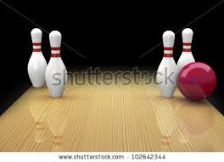
Split
A split is when the first ball of a frame knocks down the headpin (the pin closest to you) but leaves two or more pins that are non-adjacent.
It's tough to hit a spare in this situation, especially if you have a 7-10 split, which is the hardest split to hit.

Slide 21
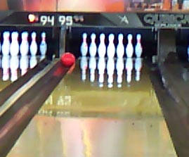
GUTTER BALL
A ball rolled in the gutter when no pins are knocked down

Slide 22
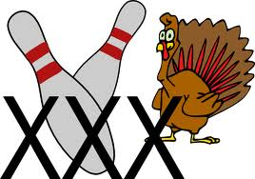
TURKEY
3 strikes bowled in a row

Slide 23
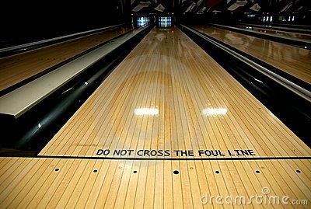
FOUL
When a bowler crosses over the foul line

Slide 24
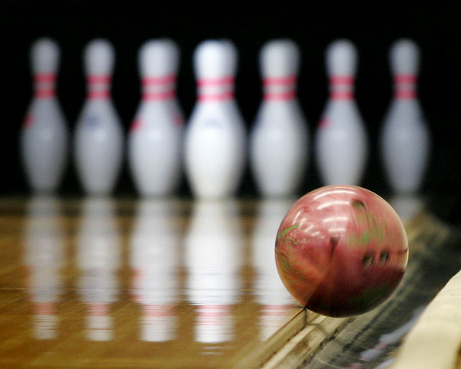
HOOK
A spin put on the ball when rolling it that curves into the strike pocket.
HOOK BALL VIDEO

Slide 25
Some Bowling Alleys in Austin
AMF @ IH 35
Westgate Lanes @ William Cannon
Dart Bowl @ Grover Ave
The Goodnight @ Anderson Lane
Main Event @ Hwy 183
The Underground @ Guadulupe
Highland Lanes @ Burnet Rd

